Slide 1
Lecture 10: Time & Clocks
CDK4: Sections 11.1 – 11.4
CDK5: Sections 14.1 – 14.4
TVS: Sections 6.1 – 6.2
Topics:
Synchronization
Logical time (Lamport)
Vector clocks
We assume there are benefits from having different systems in a network able to agree the answers to time-related questions ….

Slide 2
Synchronization
Two parts:
  Difficulty of setting the same time
  Clock drift – i.e. difficulty of maintaining synchronization once achieved
COMP28112 Lecture 10

Slide 3
UTC (Coordinated Universal Time)
International Atomic Time – derived from clocks with “atomic oscillators”, drift rate about 1 in 10^13
Astronomical time derived from stars, sun, etc.
Slowing of earth’s rotation leads to divergence
UTC based on atomic time, but with occasional insertion of leap seconds to keep it in step with astronomical time
UTC broadcast by terrestrial radio and satellite (GPS)
COMP28112 Lecture 10

Slide 4
Computer Time
GPS receivers accurate to about 1 microsec.
Receivers from terrestrial stations, or over dedicated telephone line – to a few millisec.
In reality few computers in a network have either of these ways of setting the time
And then there is drift (typically 1 in 10^6 for inexpensive crystal clocks)
COMP28112 Lecture 10

Slide 5
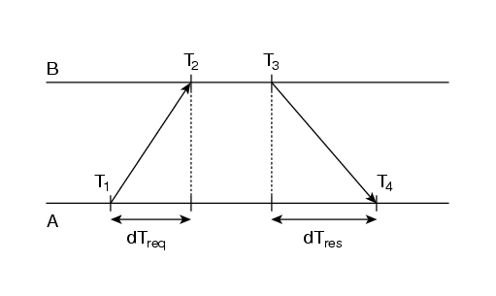
TVS figure 6.6 – synchronizing clocks
A’s offset from B:
( (T2 – T1) + (T4 – T3) ) /2
COMP28112 Lecture 10

Slide 6
Cristian’s Clock Synchonization
With a “time server”, clients set their own clocks by measuring the round-trip time to process their request, rtt, and adding half that to the time in the reply
Assumes time-out = time-back, more likely to be true for short rtt
If good estimate of min transmission time available can estimate accuracy
COMP28112 Lecture 10

Slide 7
The Berkeley Algorithm
1 processor, the master, polls others (slaves)
Slaves reply with their times
Master estimates their local times using round-trip times (as above)
Master averages all these (and own time) – eliminating any times with excessive rtt
Also eliminates any clocks wrong wrt others
COMP28112 Lecture 10

Slide 8
The Berkeley Algorithm (cont.)
Rather than send back correct time, master sends back to each slave its own delta (+/-)
If the master fails, a distributed election algorithm exists to elect one of the slaves as replacement
Cristian’s algorithm & the Berkeley algorithm designed (primarily) for intranets
COMP28112 Lecture 10

Slide 9
Network Time Protocol (NTP)
Designed for larger scale internet
Network of servers:
  Primary (stratum 1)– with UTC clock
  Secondary (stratum 2), synchronized with primary
Can reconfigure – e.g. if UTC source fails primary can become secondary, etc.
COMP28112 Lecture 10

Slide 10
NTP Synchronization
Three methods of synchronization
  Multicast mode
  Procedure call mode
  Symmetric mode
Multicast mode used on high-speed LANs
  Server sends time to all servers on LAN at once
  Each reset clocks (assuming a small delay)
  Not highly accurate
COMP28112 Lecture 10

Slide 11
Procedure-call mode
Procedure-call mode:
  Effectively Cristian’s algorithm
  Server accepts requests and replies with the time
  Used when multicast not supported or higher accuracy required
Symmetric mode
  Used where highest accuracy is required
  Messages exchanged, and data built up to improve accuracy of synchronization over time.
  Each message sent contains timing info about the previous message received (time sent, time received) and time it is sent
COMP28112 Lecture 10

Slide 12
CDK Figure 11.4
Messages exchanged between a pair of NTP peers
Server B
T
T
i
-2
i-1
Time
m
m'
Time
Server A
T
T
i
-
3
i
COMP28112 Lecture 10

Slide 13
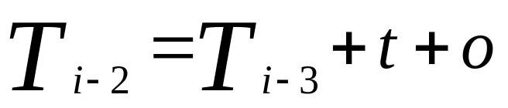
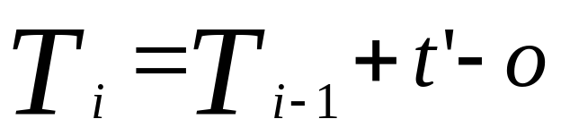
Using the information
Use this information to estimate the offset between the two clocks, o, from the equations (where t, t’ are transmission times for m, m’ resp.), and a d, delay, total transmission time of the two messages.
Hence:
COMP28112 Lecture 10

Slide 14
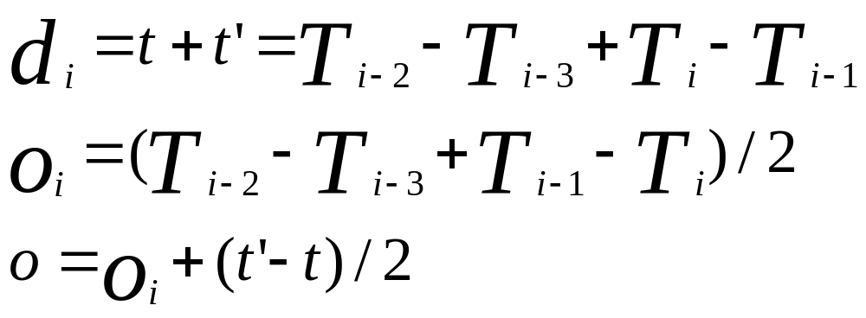
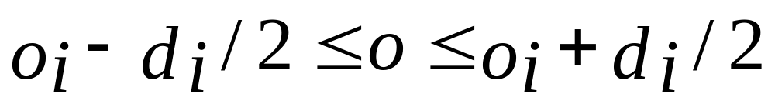
Using the fact that t and t’ are both >= 0, leads to
COMP28112 Lecture 10

Slide 15
Data filtering
NTP servers filters successive (o,d) values to identify best (lowest d value), and measure the reliability of the other server
Each server will interact with several peers identifying most reliable ones
Achieves accuracies of 10s of millisec over internet paths
COMP28112 Lecture 10

Slide 16
Logical Time (Lamport)
In single processor, every event can be uniquely ordered in time using the local clock
What we want is to be able to do this in a distributed system, where synchronization between clocks is not sufficiently good to use physical time
COMP28112 Lecture 10

Slide 17
Simple principles
If two events happen in the same process, they occur in the order given by that process
If a message is sent from 1 process to another, the event of sending happens before the event of receiving
These define a partial ordering of events, given by the happens-before relationship
COMP28112 Lecture 10

Slide 18
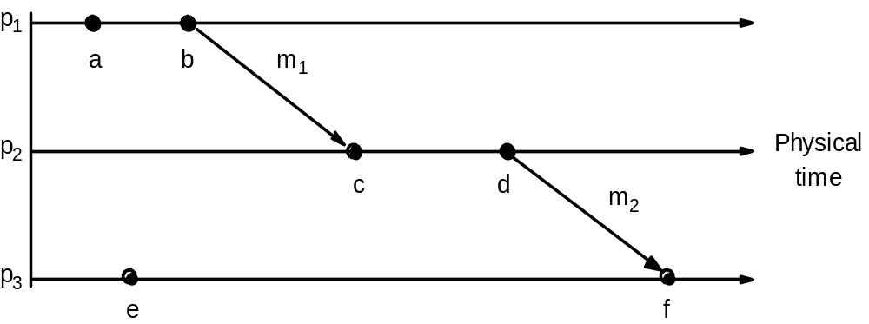
CDK Figure 11.5
Events occurring at three processes
COMP28112 Lecture 10

Slide 19
Logical clocks
A logical clock is a monotonically increasing software counter
Each process keeps its own, L, and uses it to timestamp events
  L++ before each event
  Each message sent contains current L (as t)
  Each message received sets L = max(L,t)+1
COMP28112 Lecture 10

Slide 20
Logical clocks (cont.)
Now if event e1 happens-before e2, L(e1) < L(e2)
Note that the converse is not true, i.e. we cannot deduce ordering from the timestamps
COMP28112 Lecture 10

Slide 21
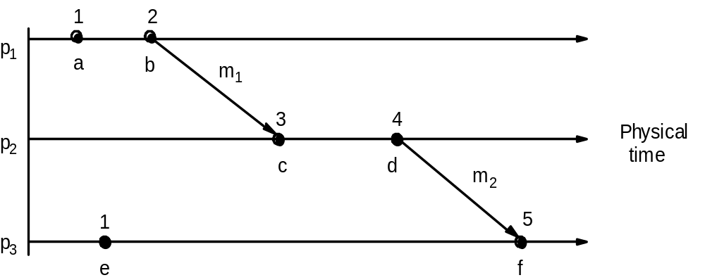
CDK Figure 11.6
Lamport timestamps for the events shown in CDK Figure 11.5
COMP28112 Lecture 10

Slide 22
Totally ordered logical clocks
Can make the ordering of events above total, so that there is an order between every pair of events, by using an ordering of process identifiers (using local timestamps) to resolve cases where logical clocks are the same in different processes
This has no physical reality, but may be used to control entry to critical sections, etc.
COMP28112 Lecture 10

Slide 23
Vector Clocks
A vector clock in a system with n processes is an array of n integers
Each process keeps its own
Messages between processes contain the vector clock of the sender as a timestamp
Each clock starts with all integers 0
COMP28112 Lecture 10

Slide 24
Vector clocks (cont.)
Events in process i increment the i’th element in its vector clock
When process i receives a timestamp, t, in a message it resets each element in its clock V[j] = max(V[j], t[j] ) for j = 1 …n
This operation is referred to as a merge
COMP28112 Lecture 10

Slide 25
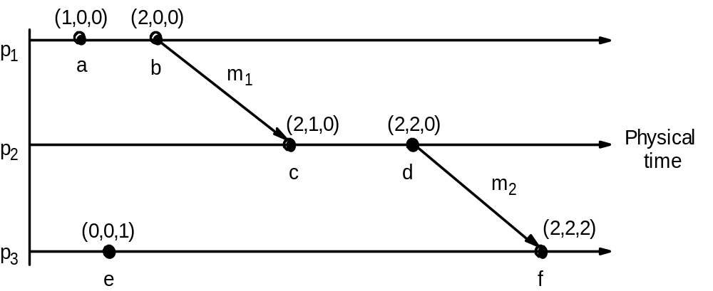
CDK Figure 11.7
Vector timestamps for the events shown in CDK Figure 11.5
COMP28112 Lecture 10

Slide 26
Comparing Vector clocks
V1 = V2 iff V1[j] = V2[j] for all j
V1 <= V2 iff V1[j] <= V2[j] for all j
V1 < V2 iff V1 <= V2 & V1 != V2
Now if event e1 happened-before event e2, V(e1) < V(e2)
if V(e1) < V(e2), e1 happened-before e2
COMP28112 Lecture 10

Slide 27
Advantages and Disadvantages
We don’t end up with an arbitrary order when none is needed (e.g. between c and e in the figures: neither V(c) < V(e)
nor V(e) < V(c) )
Cost is the extra amount of data in a timestamp.
Lamport’s clocks do not capture causality, which can be captured by means of vector clocks.
COMP28112 Lecture 10

